Slide 1

SNOWFLAKE TRAININGs

Slide 2
Learning Objectives-Day 6
What we are going to learn (major topics or major subjects) A- Data Types in Snowflake? B- Create table and different types of tables, C- Types of Constraints in Snowflake? D- Query Execution flow in Snowflake E- Views and Materialized view. F- Caching
Notes:
With the help of VARIANT data type, Snowflake loads semi-structured data as a VARIANT data type, enabling you to quickly query JSON in a fully relational manner.

Slide 3
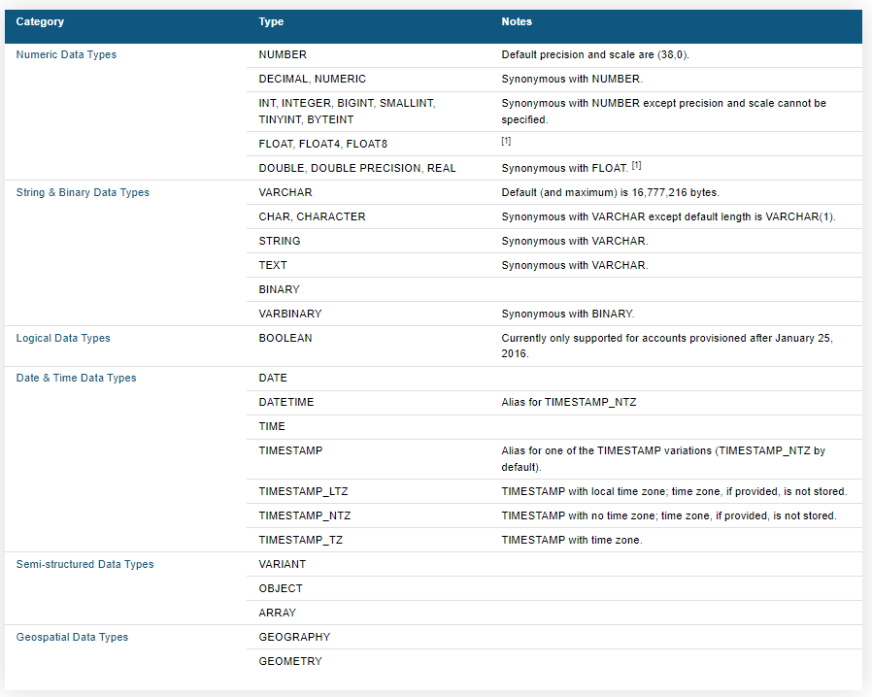
Data Types in Snowflake

Slide 4
Tables & It’s Type
Creates a new table in the current/specified schema or replaces an existing table. A table can have multiple columns, with each column definition consisting of a name, data type, and optionally whether the column:
Requires a value (NOT NULL).
Has a default value.
Has any referential integrity constraints (primary key, foreign key, etc.)
We can run other command as well than creating a table. ALTER TABLE, DROP TABLE , DESCRIBE TABLE & SHOW TABLES
We have main 4 types of table.
A- Permanent B- Temporary C-Transient Table D-External Table (AWS,AZURE,GCP)

Slide 5
Tables & Their Properties
Snowflake Tables | Permanent (Default) | Transient | Temporary | External
Syntax | CREATE TABLE <TABLENAME> | CREATE TRANSIENT TABLE <TABLENAME> | CREATE TEMPORARY TABLE <TABLENAME> | CREATE EXTERNAL TABLE <TABLENAME>
Persistence | Until explictily Dropped | Until explictily Dropped | Remainder of Session | Until explictily Dropped
Time Travel (Retention) | 0-90days* (20) | 0 or 1 | 0 or 1 | 0
Fail Safe | 7 | 0 | 0 | 0
Cloning | Yes, Can be cloned in Permanent ,Transient & Temporary Table | Yes, Can be cloned in Transient & Temporary Table | Yes, Can be cloned in Transient & Temporary Table | No
View creation | Yes | Yes | Yes | Yes

Slide 6
Types of Constraints
1- PRIMARY KEY –no dupes no null values (1,2,3,4,5) 2- UNIQUE --no dupes but a single null allowed 3- DEFAULT– default value will be inserted in column 4- FOREIGN KEY – will be having only those values which are in PK(1,1,2,3,3,4,5,nul ) *6,7,8 5- NOT NULL (enforced by snowflake) Note: Snowflake supports defining and maintaining constraints, but does not enforce them, except for NOT NULL constraints, which are always enforced. Constraints are provided primarily for data modeling purposes and compatibility with other databases, as well as to support client tools that utilize constraints. For example, Tableau supports using constraints to perform join culling (join elimination), which can improve the performance of generated queries and cube refresh.

Slide 7
Views in Snowflake
View are like Virtual Tables. A view allows the result of a query to be accessed as if it were a table.
We can use view to hide the complexity of our Table calculations or to implement the Column level or row level security.
View are of Two Types
1- Normal View
2- Materialized View
Syntax: Create View <ViewName> AS Select Column1,column2 from Table
Normal View
A view is basically a named definition of a query. A non-materialized view’s results are created by executing the query at the time that the view is referenced in a query. The results are not stored for future use. Performance is slower than with materialized views. Non-materialized views are the most common type of view.
Any query expression that returns a valid result can be used to create a non-materialized view, such as:
Selecting some (or all) columns in a table.
Selecting a specific range of data in table columns.
Joining data from two or more tables.
Materialized Views are designed to improve performance. Materialized Views contain a copy of a subset of the data in a table. Depending upon the amount of data in the table and in the materialized view, scanning the materialized view can be much faster than scanning the table. Materialized views also support clustering
Notes:
In a cluster, each machine is largely independent of the others in terms of memory, disk, etc.
They are interconnected using some variation on normal networking.
The cluster exists mostly in the mind of the programmer and how s/he chooses to distribute the work.
In a Massively Parallel Processor, there really is only one machine with thousands of CPUs tightly interconnected.
MPPs have exotic memory architectures to allow extremely high speed exchange of intermediate results with neighboring processors.

Slide 8
Advantages & Limitation of Views
Advantages
View Enables us to write more modular Code
View Allow granting access to a Subset of a Table
View can increase Performance
Limitation:
We can not alter the Views, Definition can not be updated or altered
Changes to a table are not automatically propagated to views created on that table
Views are read only
Notes:
In a cluster, each machine is largely independent of the others in terms of memory, disk, etc.
They are interconnected using some variation on normal networking.
The cluster exists mostly in the mind of the programmer and how s/he chooses to distribute the work.
In a Massively Parallel Processor, there really is only one machine with thousands of CPUs tightly interconnected.
MPPs have exotic memory architectures to allow extremely high speed exchange of intermediate results with neighboring processors.

Slide 9
Normal View vs Materialized View
It is best to use a non-materialized view when the results of the view frequently change, the query isn’t so complex and expensive to rerun, and the results of the view often change. Regular views do incur compute costs but not storage costs. The compute cost to refresh the view and the storage cost will need to be weighed against the benefits of a materialized view when the results of a view change often.
Materialized views are particularly useful when:
Query results contain a small number of rows and/or columns relative to the base table (the table on which the view is defined).
Query results contain results that require significant processing, including:
Analysis of semi-structured data.
Aggregates that take a long time to calculate.
The query is on an external table (i.e. data sets stored in files in an external stage), which might have slower performance compared to querying native database tables.
The view’s base table does not change frequently.
Notes:
In a cluster, each machine is largely independent of the others in terms of memory, disk, etc.
They are interconnected using some variation on normal networking.
The cluster exists mostly in the mind of the programmer and how s/he chooses to distribute the work.
In a Massively Parallel Processor, there really is only one machine with thousands of CPUs tightly interconnected.
MPPs have exotic memory architectures to allow extremely high speed exchange of intermediate results with neighboring processors.

Slide 10
Materialized View Cost
Materialized views are designed to improve query performance for workloads composed of common, repeated query patterns. However, materializing intermediate results incurs additional cost As such, before creating any materialized views, you should consider whether the costs are offset by the savings from re-using these results frequently enough.
Materialized views impact your costs for both storage and compute resources:
Storage: Each materialized view stores query results, which adds to the monthly storage usage for your account.
Compute resources: In order to prevent materialized views from becoming out-of-date, Snowflake performs automatic background maintenance of materialized views. When a base table changes, all materialized views defined on the table are updated by a background service that uses compute resources provided by Snowflake.
These updates can consume significant resources, resulting in increased credit usage. However, Snowflake ensures efficient credit usage by billing your account only for the actual resources used. Billing is calculated in 1-second increments.
Notes:
In a cluster, each machine is largely independent of the others in terms of memory, disk, etc.
They are interconnected using some variation on normal networking.
The cluster exists mostly in the mind of the programmer and how s/he chooses to distribute the work.
In a Massively Parallel Processor, there really is only one machine with thousands of CPUs tightly interconnected.
MPPs have exotic memory architectures to allow extremely high speed exchange of intermediate results with neighboring processors.

Slide 11
MAIN DIFFERENCES
Feature | MV | Normal View
Query from multiple table | NO | YES
Support for self join | NO | YES
Pre computed dataset | Yes | NO
GOOD Query performance | YES (data reterival faster) | NO
STORAGE COST | YES | NO
COMPUTE COST | CHARGE ON BASE TABLE UPDATES | Charged on query

Slide 12
Snowflake Stages
Snowflake Stages are locations where data files are stored (“staged”) which helps in loading data into and unloading data out of database tables. The stage locations could be internal or external to Snowflake environment.
Types of Snowflake Stages:
1- Internal stages (Store the files internally within Snowflake)
2- External Stages ( Store the files in an external location (AWS S3 Bucket, Azure containers or GCP cloud storages)
Syntax: Create or replace stage <Stagename>
File Format =<fileformatname>;

Slide 13
Internal Stages in details
Internal stages are of main three types.
A- User
B- Named
C- Table
By Default each user and table in Snowflake is automatically allocated an internal stage for staging data files. In addition, you can create internal named stages
User stages are referenced using @~
Table stages are referenced using @% and have the same name as table
Named stages are referenced using @
You can check all files in stages using LIST Keyword SYNTAX: LIST @STAGENAME
Remove @MyCSV_STAGE/target_stagefile.csv.gz; This syntax used to remove files from stages.
Notes:
In a cluster, each machine is largely independent of the others in terms of memory, disk, etc.
They are interconnected using some variation on normal networking.
The cluster exists mostly in the mind of the programmer and how s/he chooses to distribute the work.
In a Massively Parallel Processor, there really is only one machine with thousands of CPUs tightly interconnected.
MPPs have exotic memory architectures to allow extremely high speed exchange of intermediate results with neighboring processors.

Slide 14
PUT Commands
Uploads (i.e. stages) data files from a local directory/folder on a client machine to one of the following Snowflake stages:
Named internal stage.
Internal stage for a specified table.
Internal stage for the current user.
Syntax: PUT file://<path_to_file>/<filename> internalStage
You must include the drive and backslash in the path (e.g. file://C:\temp\load)
If the stage name or path includes spaces or special characters, it must be enclosed in single quotes (e.g. '@"my stage"' for a stage named "my stage")
Notes:
In a cluster, each machine is largely independent of the others in terms of memory, disk, etc.
They are interconnected using some variation on normal networking.
The cluster exists mostly in the mind of the programmer and how s/he chooses to distribute the work.
In a Massively Parallel Processor, there really is only one machine with thousands of CPUs tightly interconnected.
MPPs have exotic memory architectures to allow extremely high speed exchange of intermediate results with neighboring processors.

Slide 15
GET Commands
Downloads data files from one of the following Snowflake stages to a local directory/folder on a client machine:
Named internal stage.
Internal stage for a specified table.
Internal stage for the current user.
Get does not support download the data from external stages.
Syntax: get @%mytable file:///tmp/data/;
---- Load the data from Tables to stages And then Use GET command to download any table data.
Notes:
In a cluster, each machine is largely independent of the others in terms of memory, disk, etc.
They are interconnected using some variation on normal networking.
The cluster exists mostly in the mind of the programmer and how s/he chooses to distribute the work.
In a Massively Parallel Processor, there really is only one machine with thousands of CPUs tightly interconnected.
MPPs have exotic memory architectures to allow extremely high speed exchange of intermediate results with neighboring processors.

